Slide 1
Acrylic dns and privoxy web proxy services installation and configuration.
Carlos Gerez

Slide 2
Acrylic dns.
Carlos Gerez

Slide 3
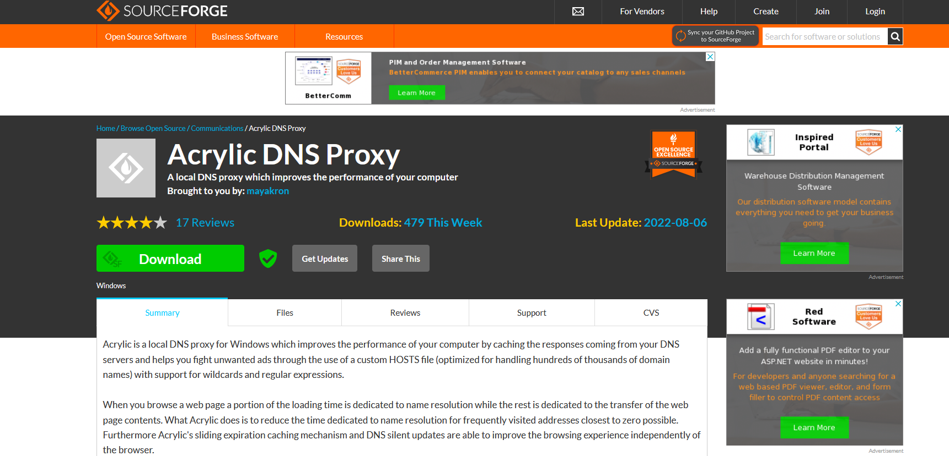
Acrylic installation on a Windows server.
Use your browser to go to: https://sourceforge.net/projects/acrylic/
This is the download page for Acrylic.

Slide 4
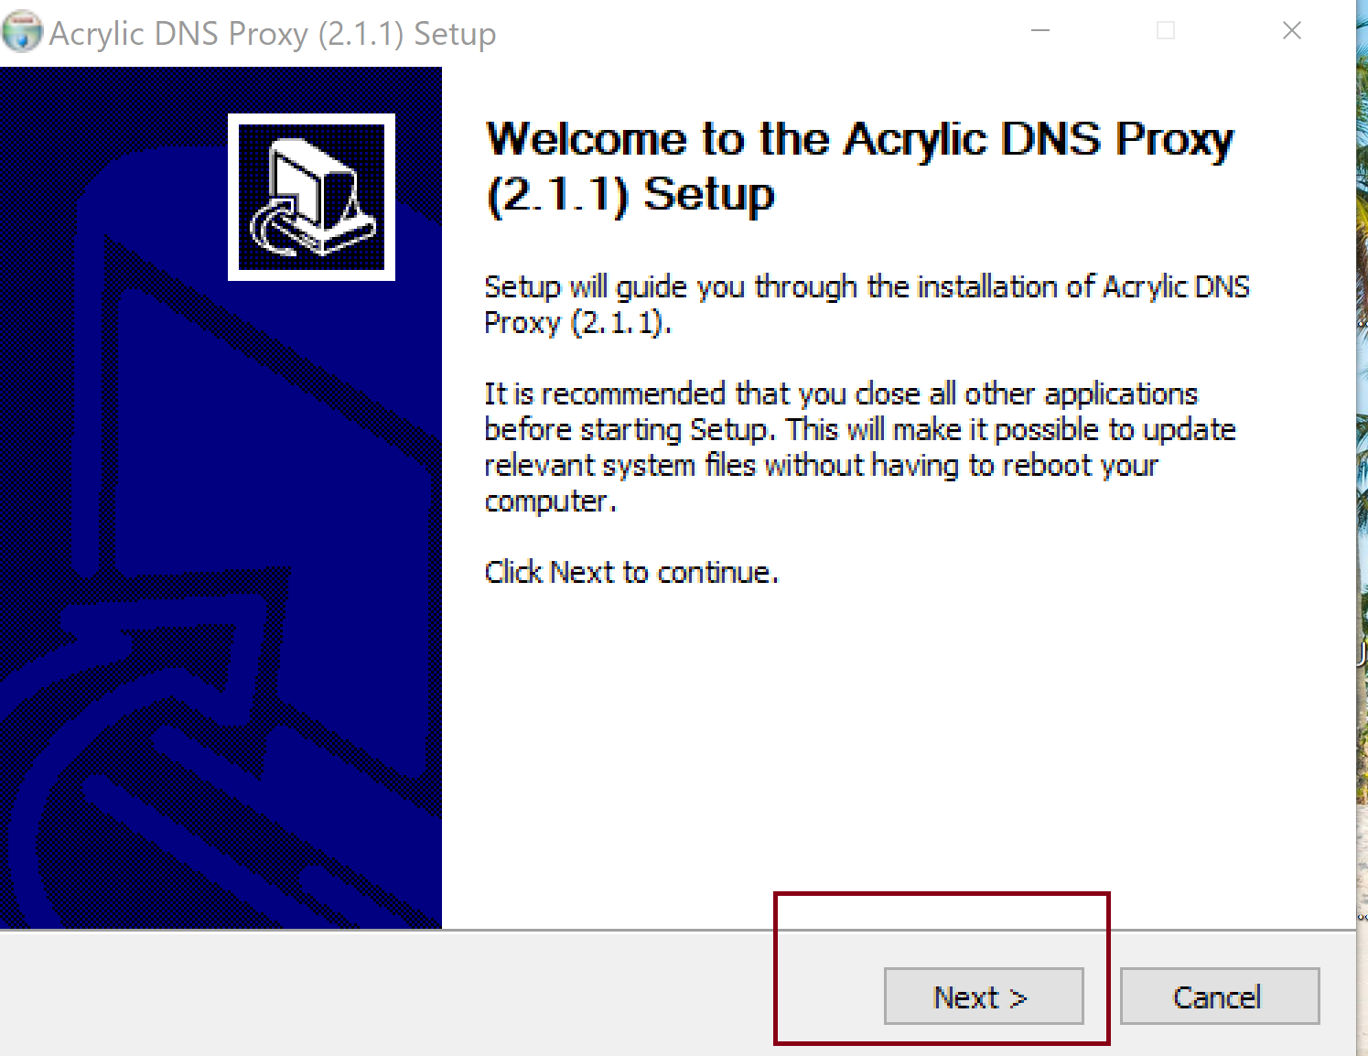
Acrylic installation on a Windows server.
After download open the installation file and follow the steps.

Slide 5
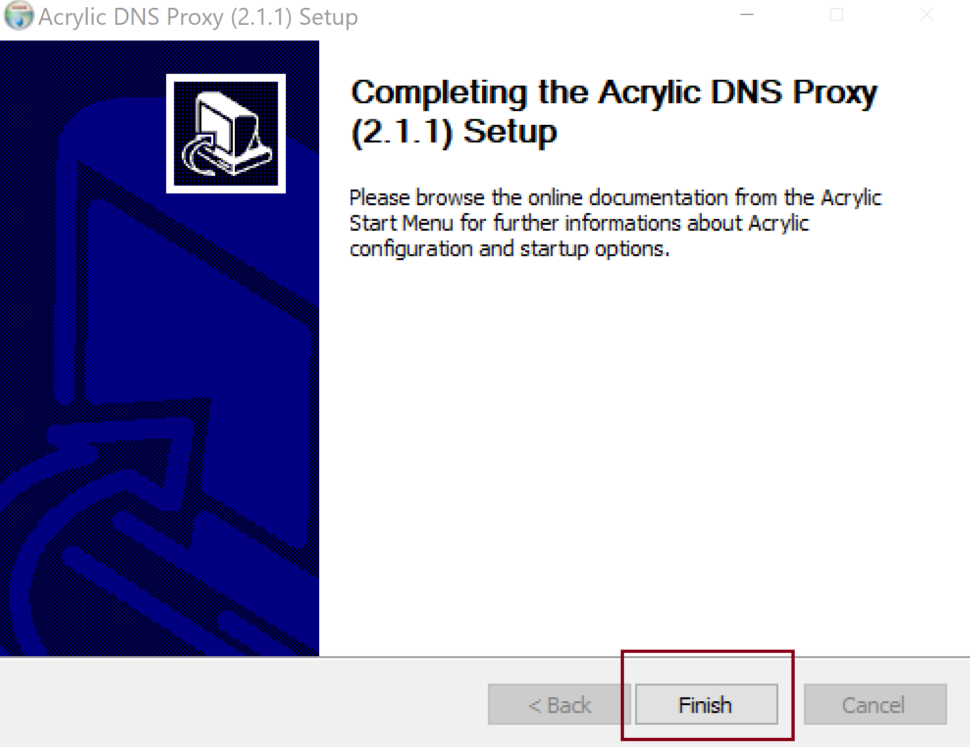
Acrylic installation on a Windows server.
Use all the default configurations presing next in each window until finish.

Slide 6
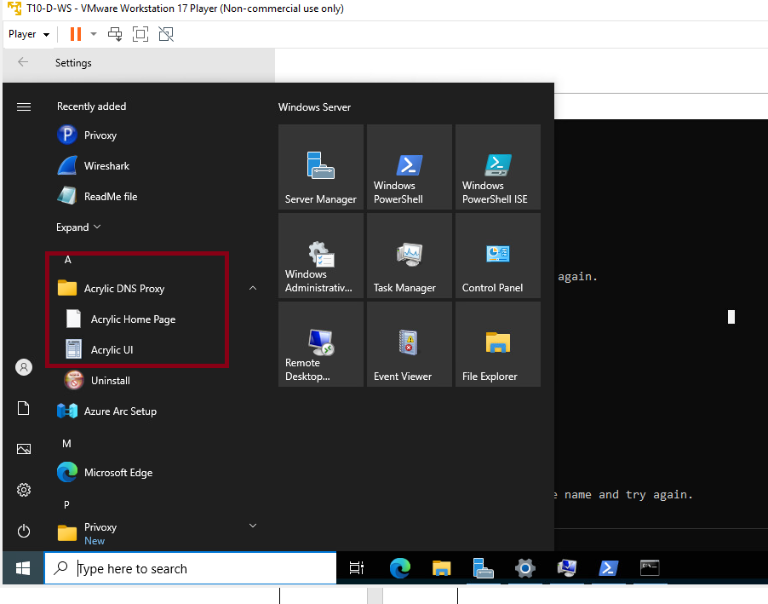
Acrylic installation on a Windows server.
Upon finishing you will have the app in your app list.

Slide 7
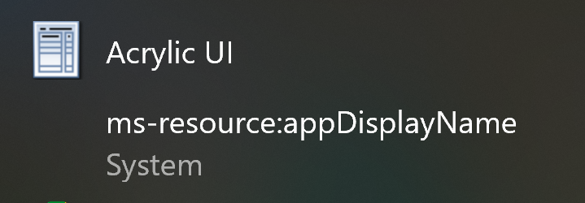
Acrylic installation on a Windows server.
The new app on your list of apps on windows is called Acrylic UI. Open the app.

Slide 8
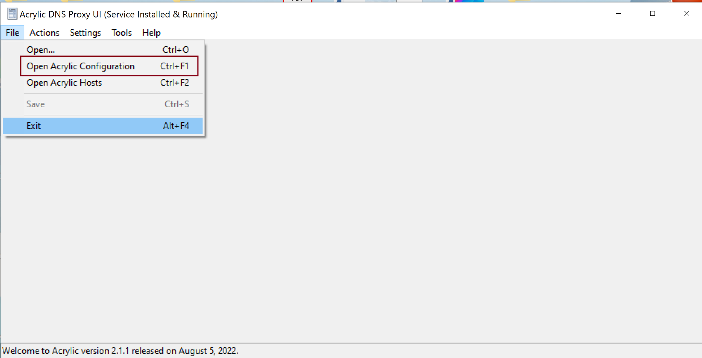
Acrylic installation on a Windows server.
This page is the UI for acrylic. Select file, and open Acrylic Configuration to configure Acrylic on this computer.

Slide 9
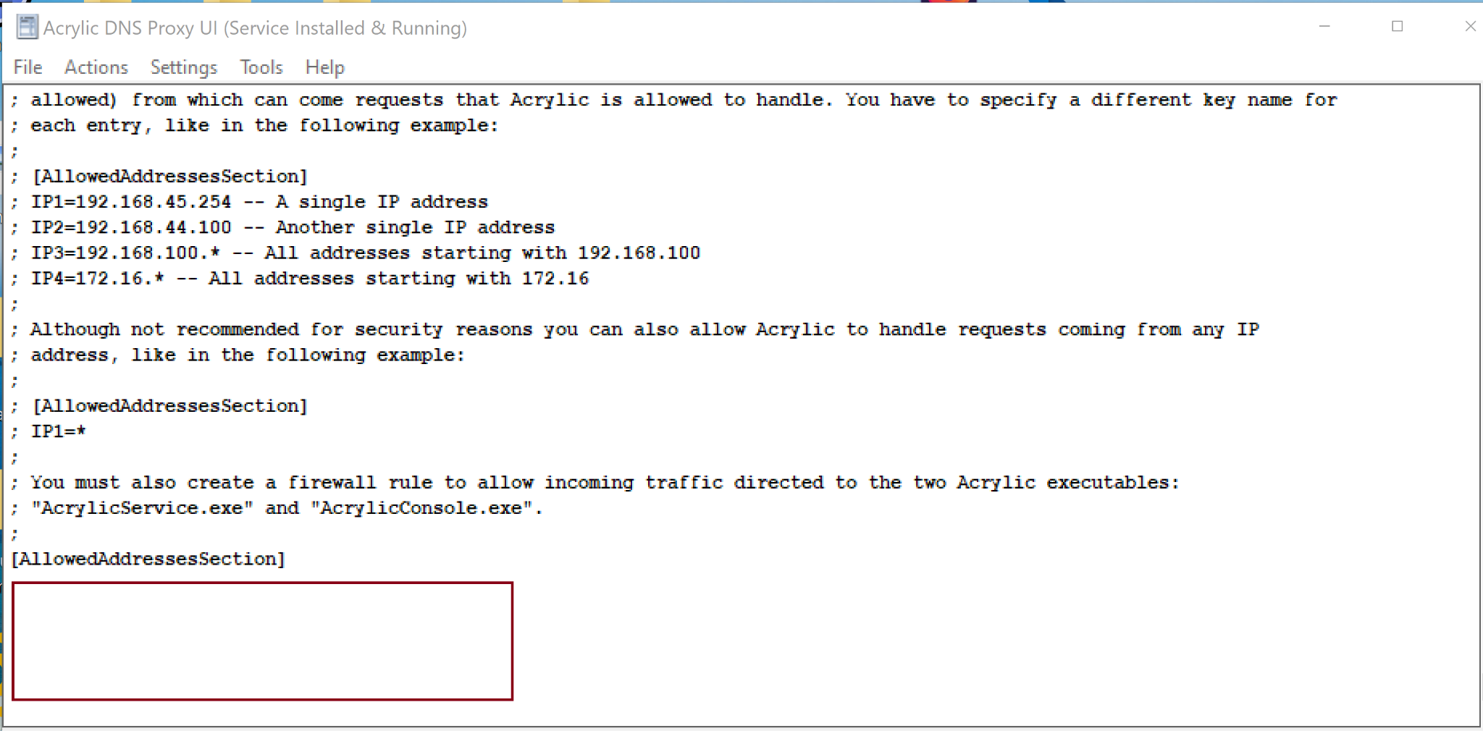
Acrylic installation on a Windows server.
Go to the last line of the file and add under the AllowedAddressSection the ip address from your computer. All the lines that start with ; are commented lines and will not be used by the app.

Slide 10
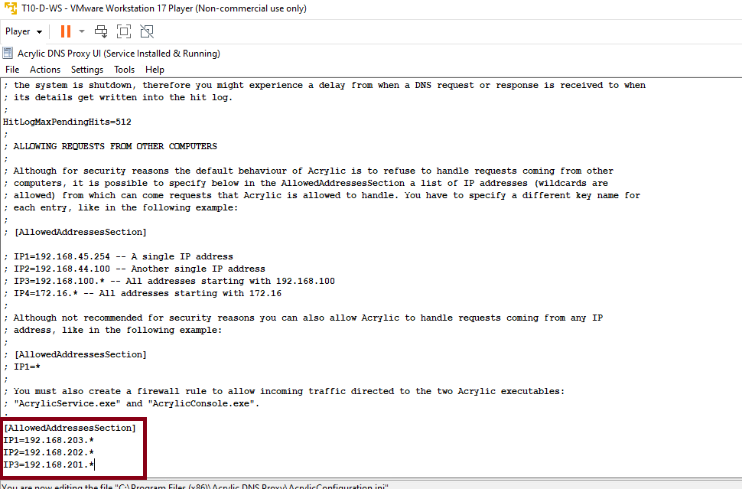
Acrylic installation on a Windows server.
Go to the last line of the file and add under the AllowedAddressSection the ip address that you will allow to receive requests from, in this case the * means all the machines on that subnet.

Slide 11
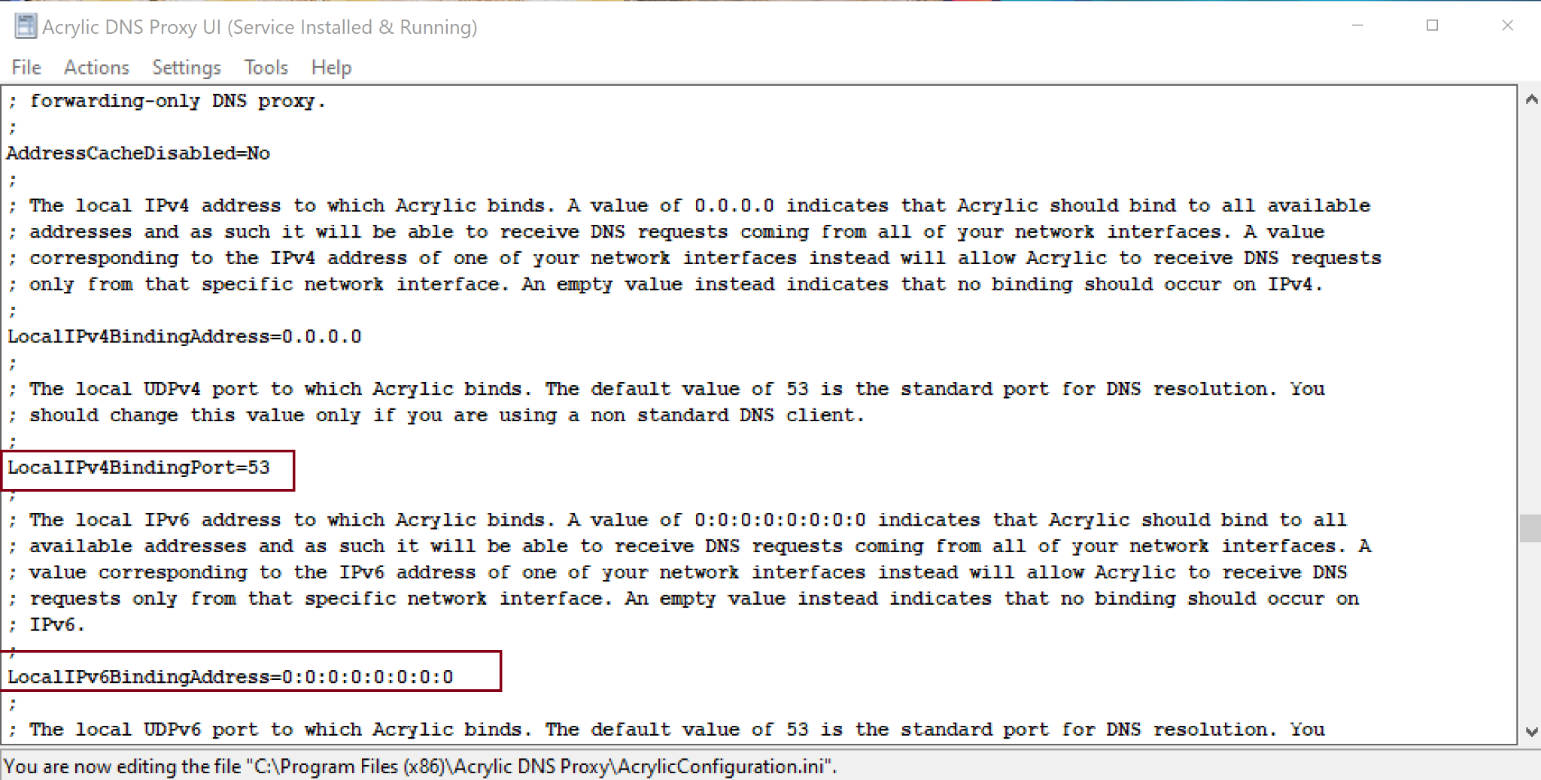
Acrylic installation on a Windows server.
There are several other configurations lines in this file that is good to know. In the LocalIPv4BindingPort, the number 53 means that is the port used by this application.

Slide 12
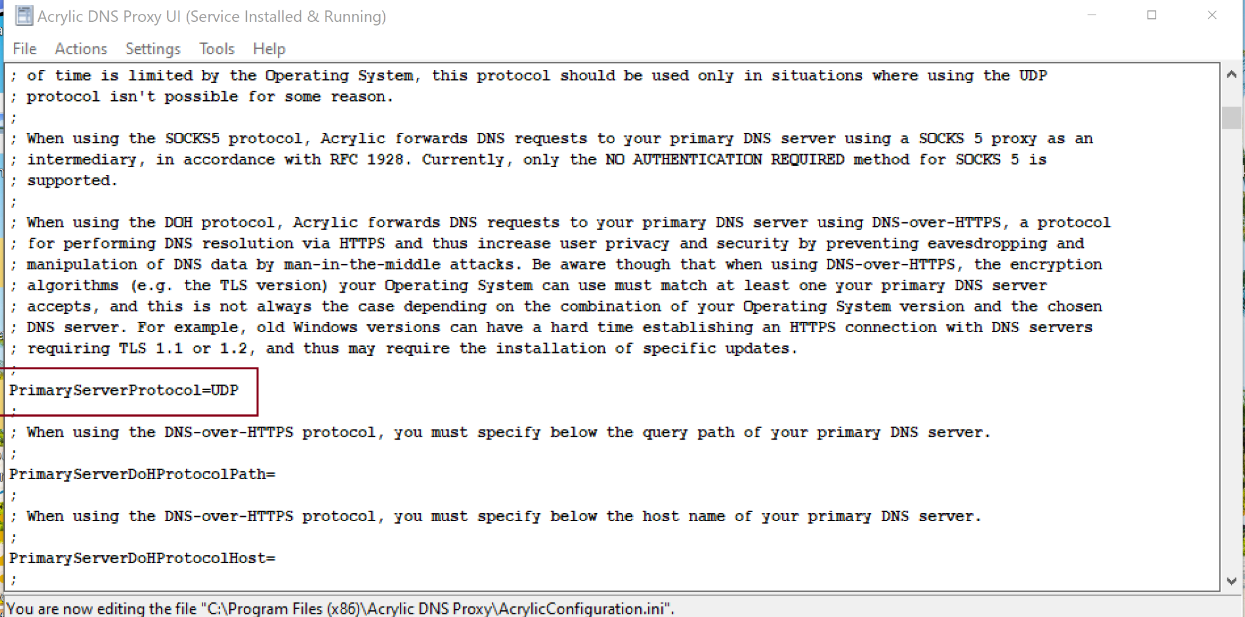
Acrylic installation on a Windows server.
Primary protocol used in default is UDP. There are more allowed protocol listed in the file in the previous lines.

Slide 13
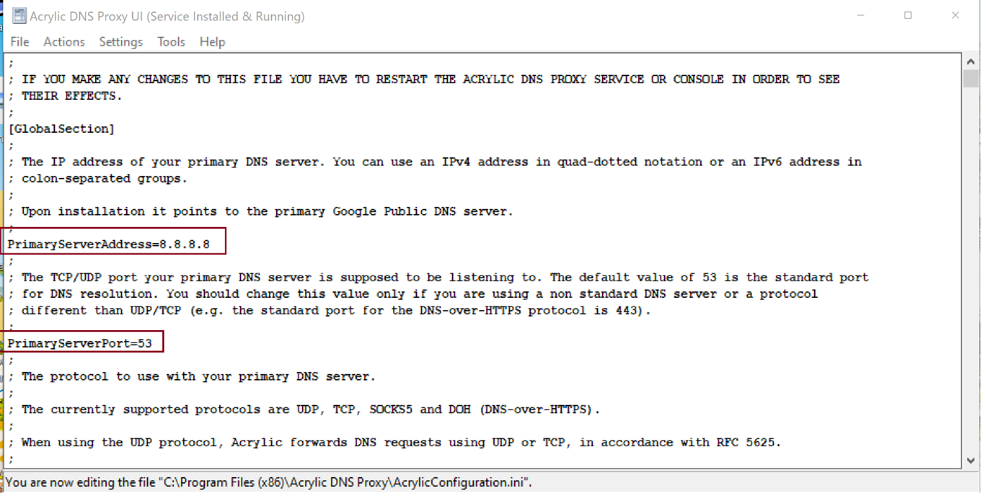
Acrylic installation on a Windows server.
Here is defined the primary server that resolve the addresses, and the primary server port.

Slide 14
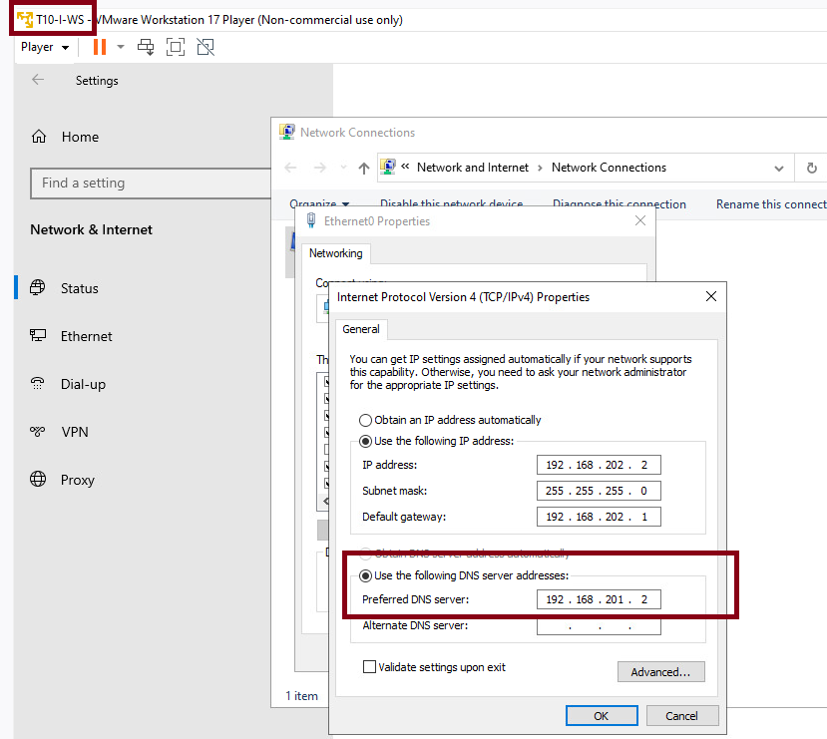
Using the dns service from a computer in the intern zone.
Here we change the dns on a machine to get their dns from the machine in the DMZ.

Slide 15
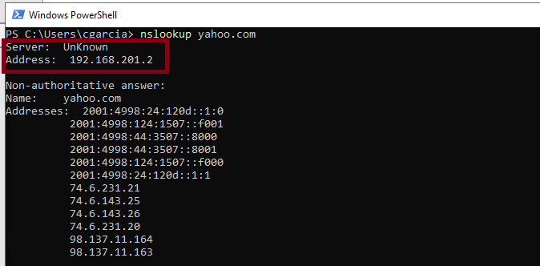
Testing the dns service resolution.
On a windows powershell we can use nslookup to resolve yahoo.com and receive the addresses of servers linked to that domain. In the top is the server that resolve those addresses on the DMZ.

Slide 16
privoxy web proxy services installation and configuration.
Carlos Gerez

Slide 17
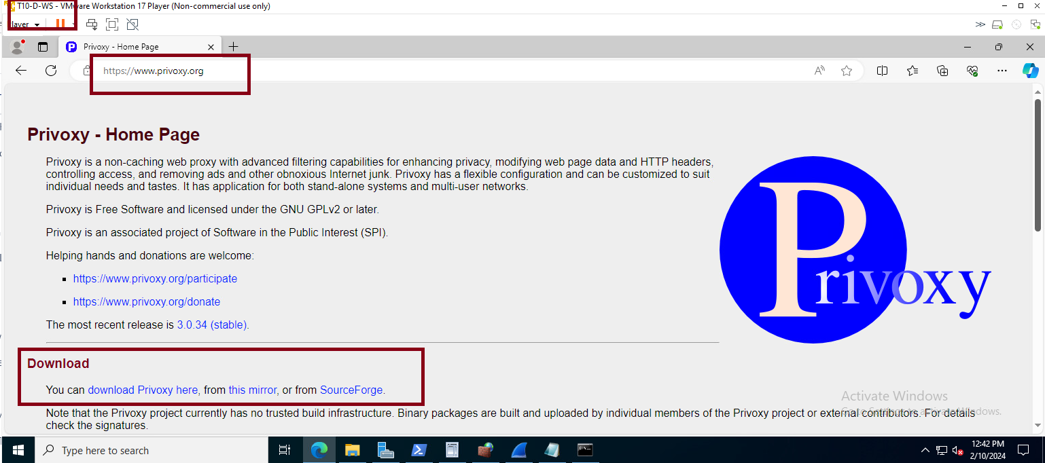
Privoxy installation in a Windows server.
On a browser on the computer in that you want to install the service search for http://www.privoxy.org/
Select download from SourceForge.

Slide 18
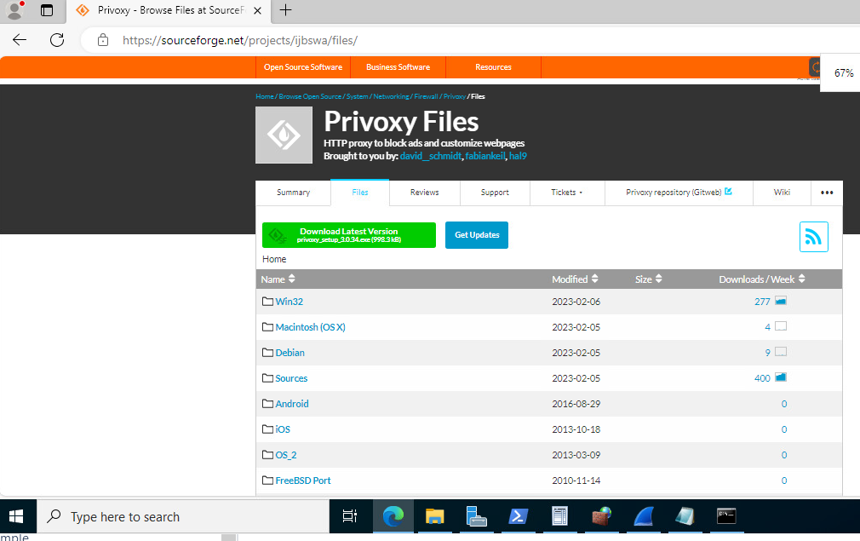
Privoxy installation in a Windows server.

Slide 19
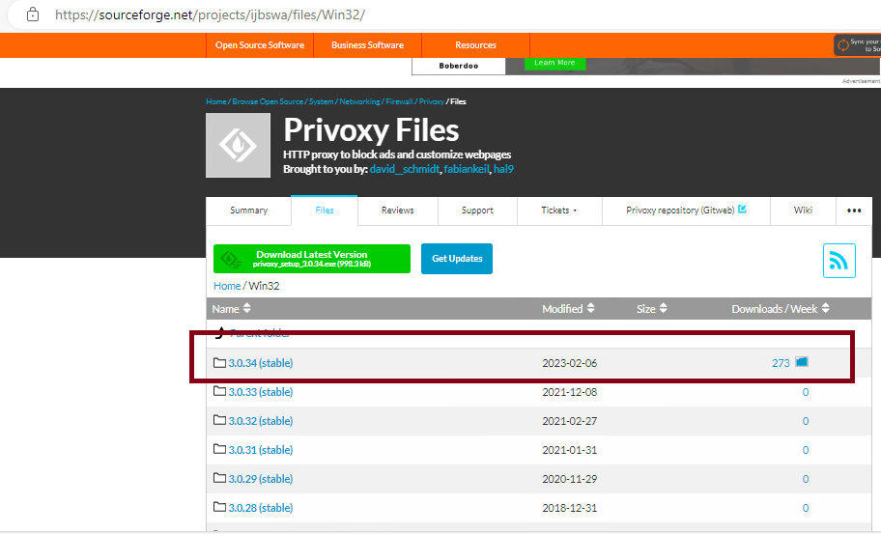
Privoxy installation in a Windows server.

Slide 20
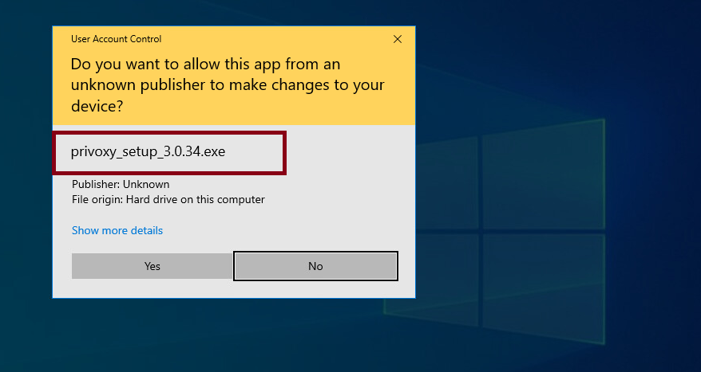
Privoxy installation in a Windows server.

Slide 21
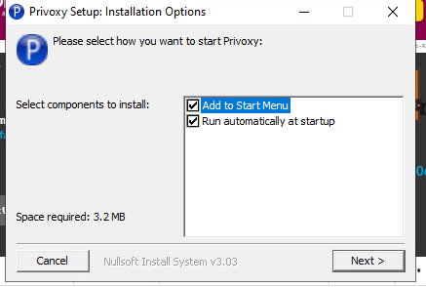
Privoxy installation in a Windows server.

Slide 22
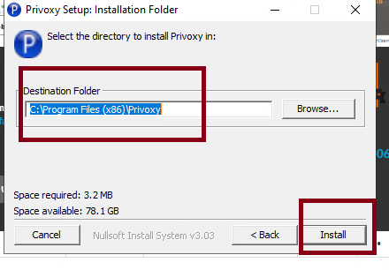
Privoxy installation in a Windows server.

Slide 23
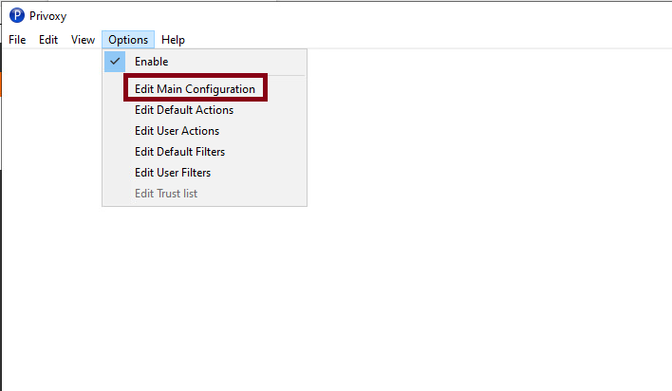
Privoxy configuration in a Windows server.

Slide 24
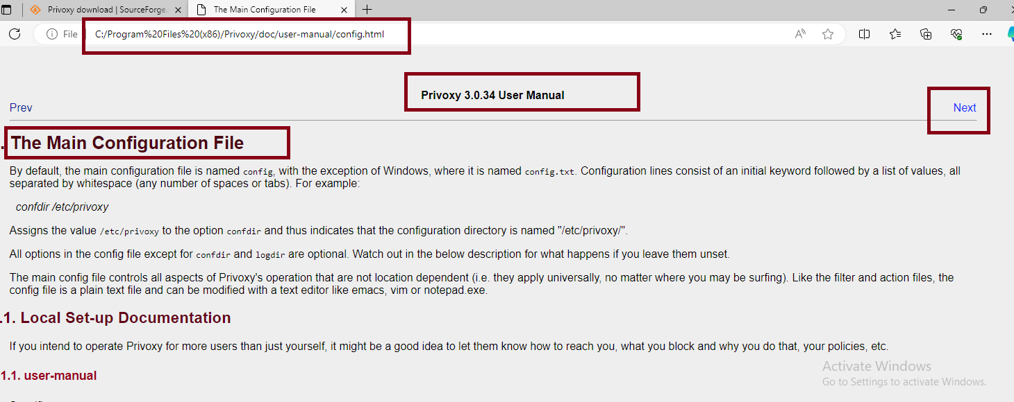
Privoxy configuration in a Windows server.
Upon open the app one can look in the web page the configuration options.

Slide 25
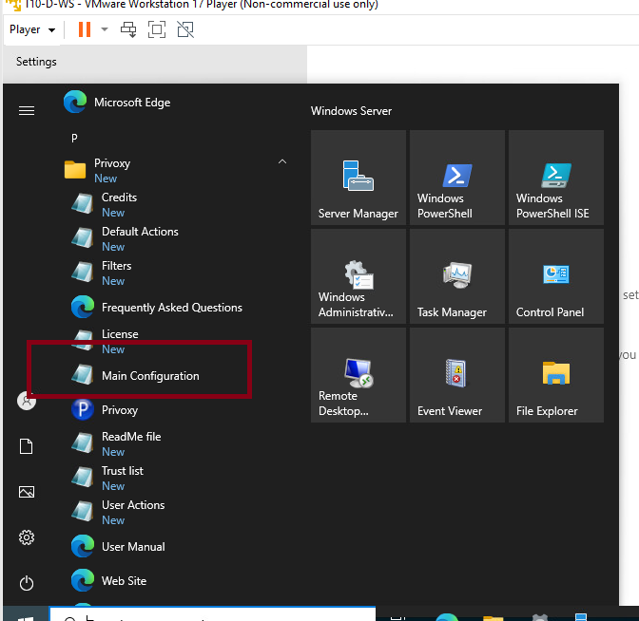
Privoxy configuration in a Windows server.
A more simple option is to open the main configuration file with administrative privileges, and edit the necessary configurations.

Slide 26
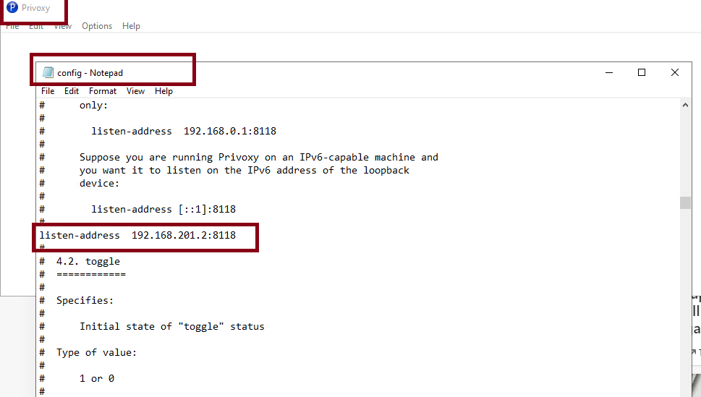
Privoxy configuration in a Windows server.
This is the only change necessary to provide web services with privoxy. In the uncommented line listen-address add the address of the computer were the service run, and the listening port used for privoxy (8118)

Slide 27
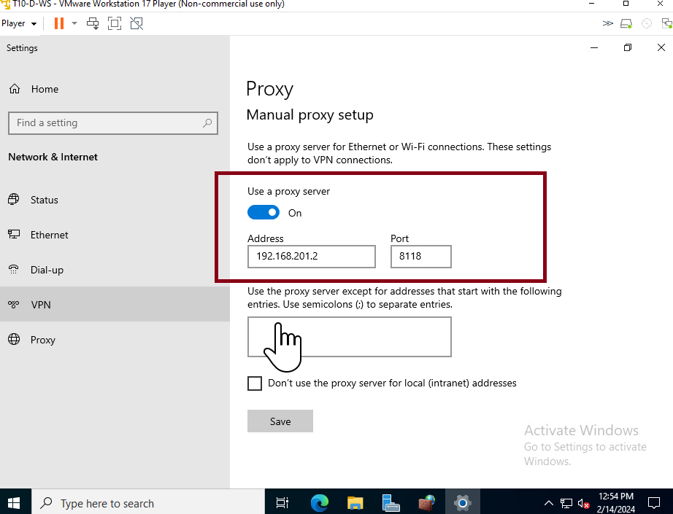
Privoxy configuration in a Windows computer.
On settings go to proxy and change use a proxy server to on and add the address and listening port.

Slide 28
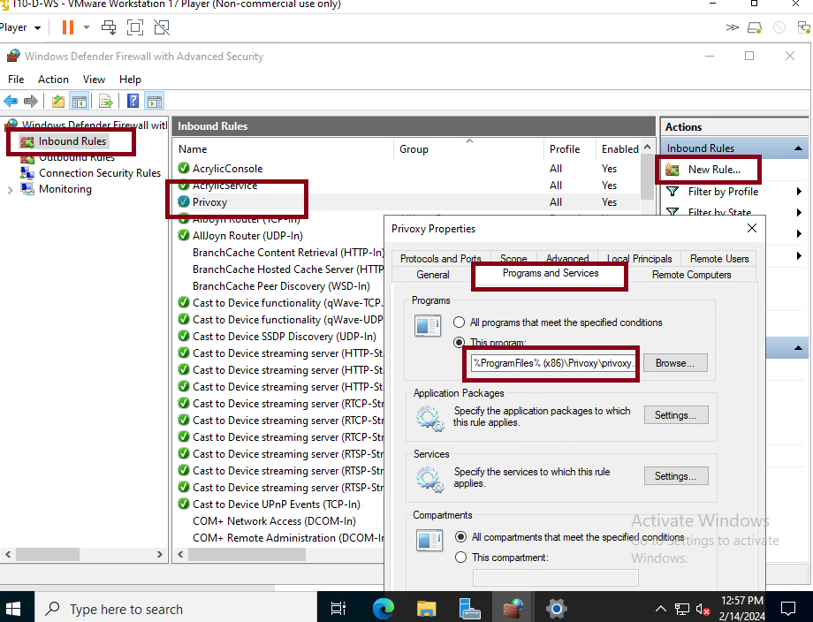
Privoxy configuration in a Windows server.
You must allow the service to receive request by creating a new rule in windows defender with advance security in windows. Create the rule to give access to privoxy by adding the path to the executable in your computer by browsing to it.

Slide 29
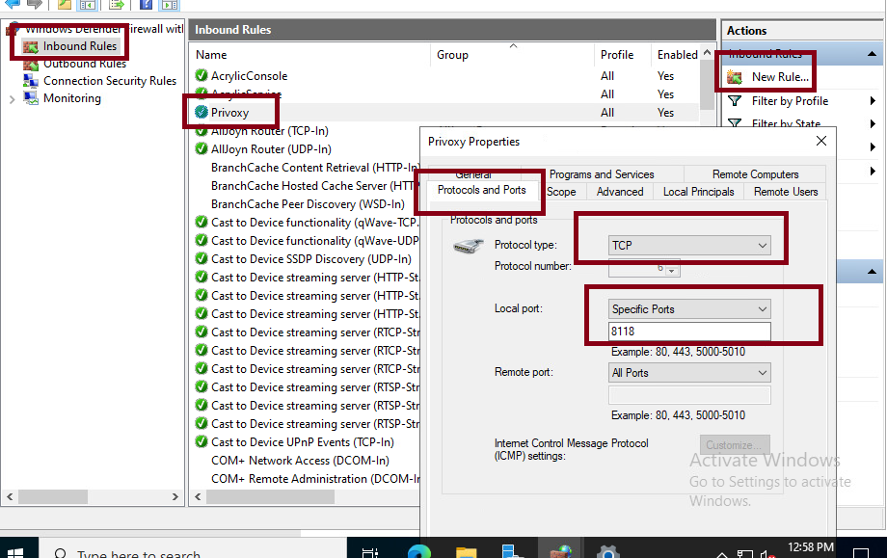
The protocols of the rule must be TCP and the port 8118. If you are not sure of this settings can edit the rule and change the configuration of the rule to match this.

Slide 30
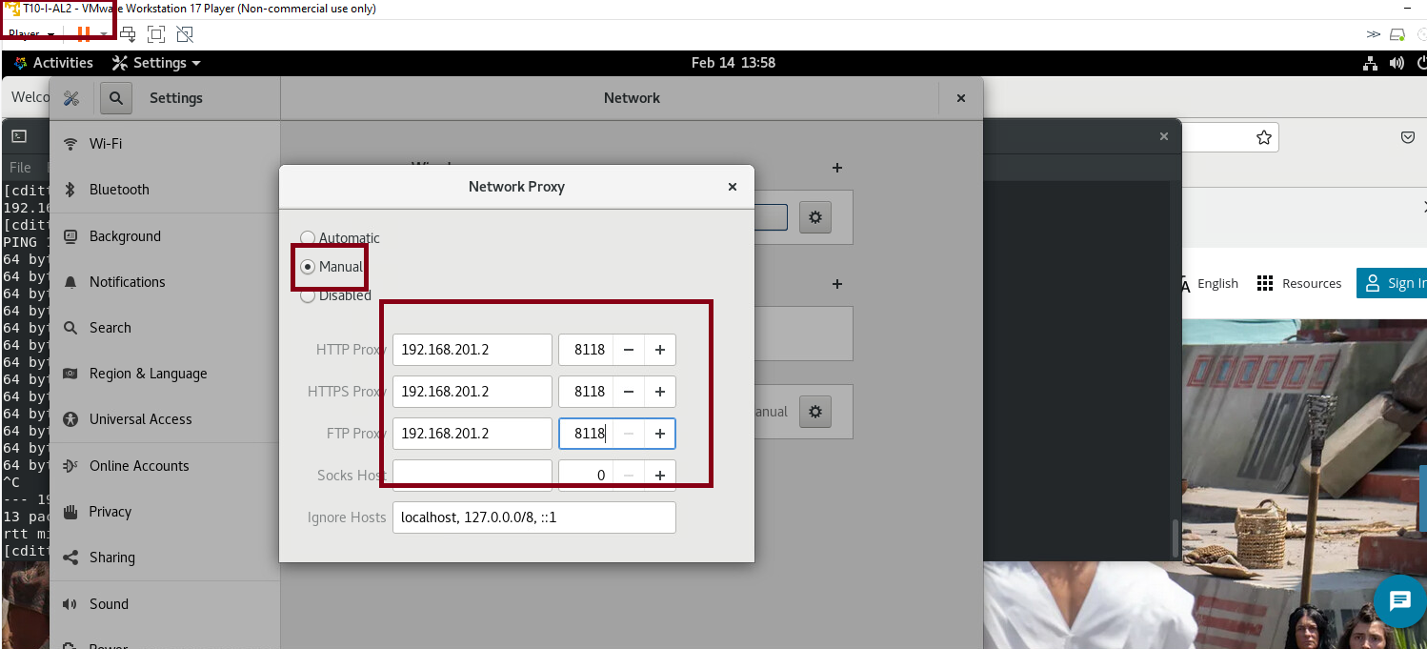
Privoxy configuration in a Alma Linux server.
Go to settings, and on network proxy change to the address that host privoxy and the listening port. Upon change this stop and start the service network to be sure the changes are updated.

Slide 31
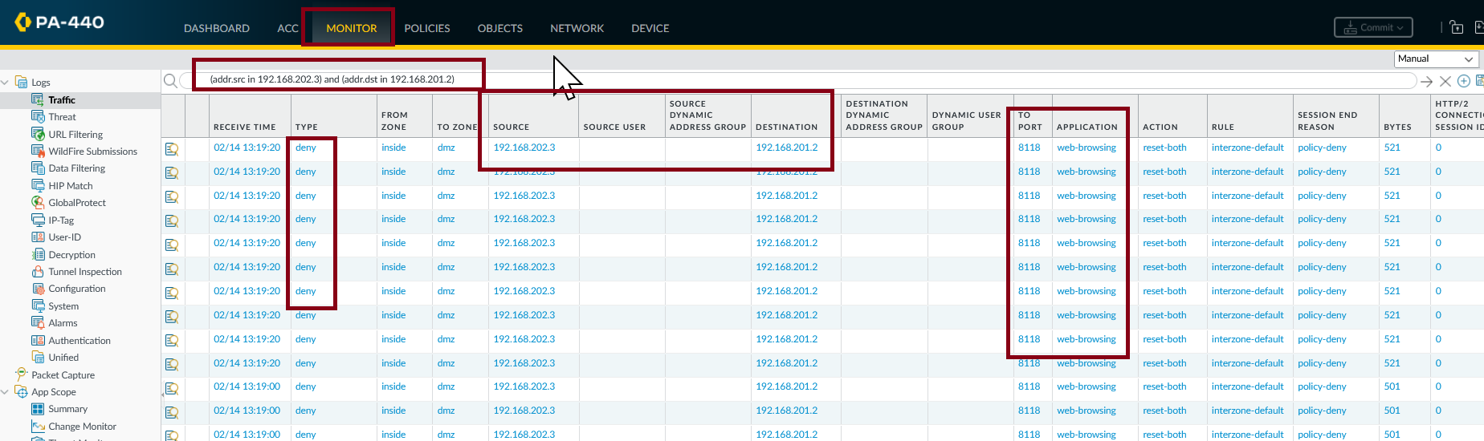
Testing the service.
The service shows problems between zones. In the Palo Alto monitor we can see many deny request. We must create a rule to allow those request to go trough.

Slide 32
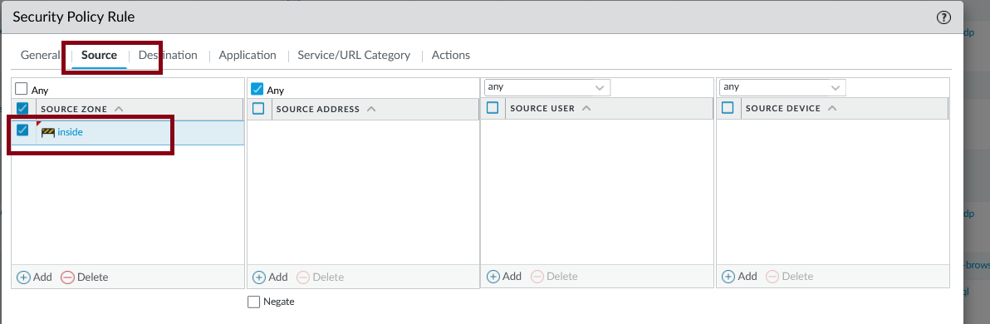
Creating a rule to allow privoxy on the Palo Alto firewall.
A new rule with source in intern and destination to DMZ will provide access to privoxy.Open on Palo Alto the policy tab and create a new policy.

Slide 33
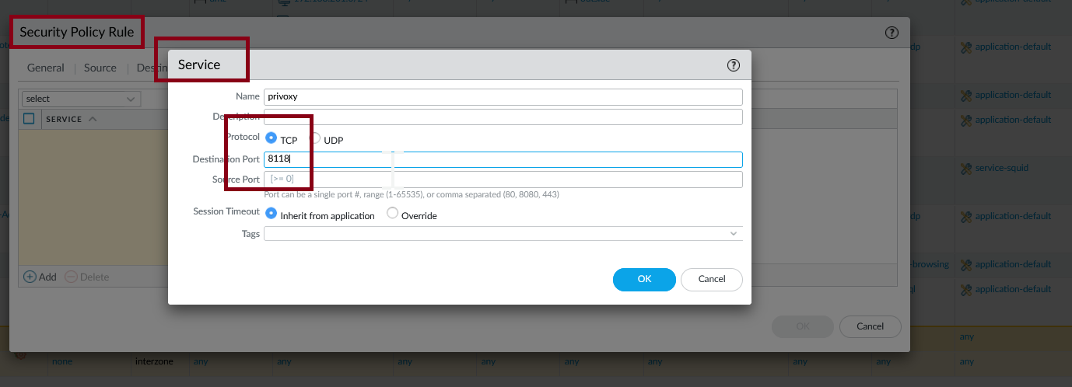
Creating a rule to allow privoxy on the Palo Alto firewall.
In the service tab create a new service call privoxy, that will use TCP and port 8118.

Slide 34
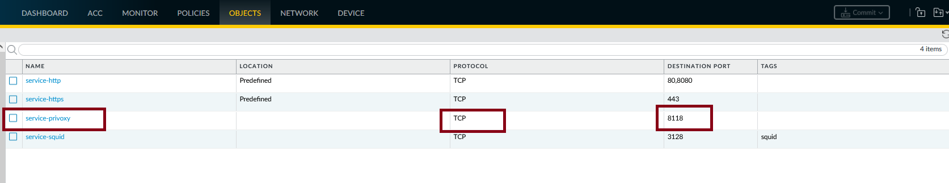
Creating a rule to allow privoxy on the Palo Alto firewall.
After the configuration changes if you look into objects you could see the new privoxy service object configuration.

Slide 35
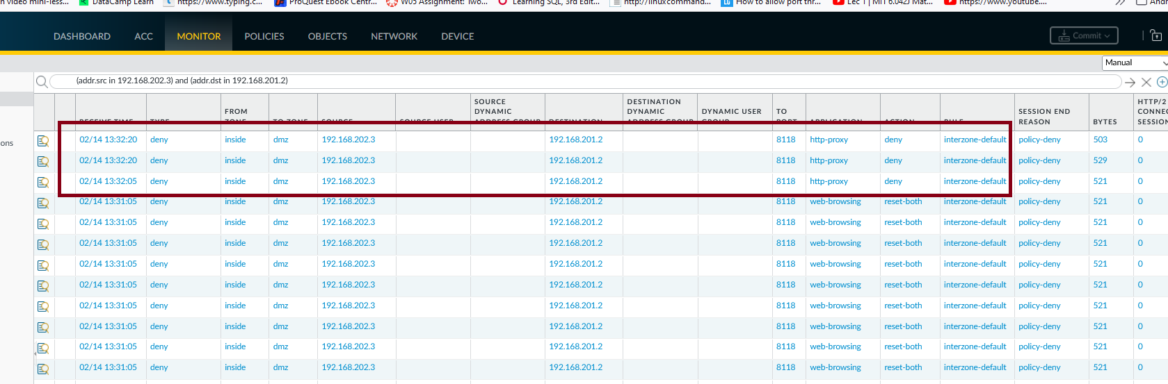
Creating a rule to allow privoxy on the Palo Alto firewall.
When trying again the web server, communications were deny but because another service is required, http-proxy.

Slide 36
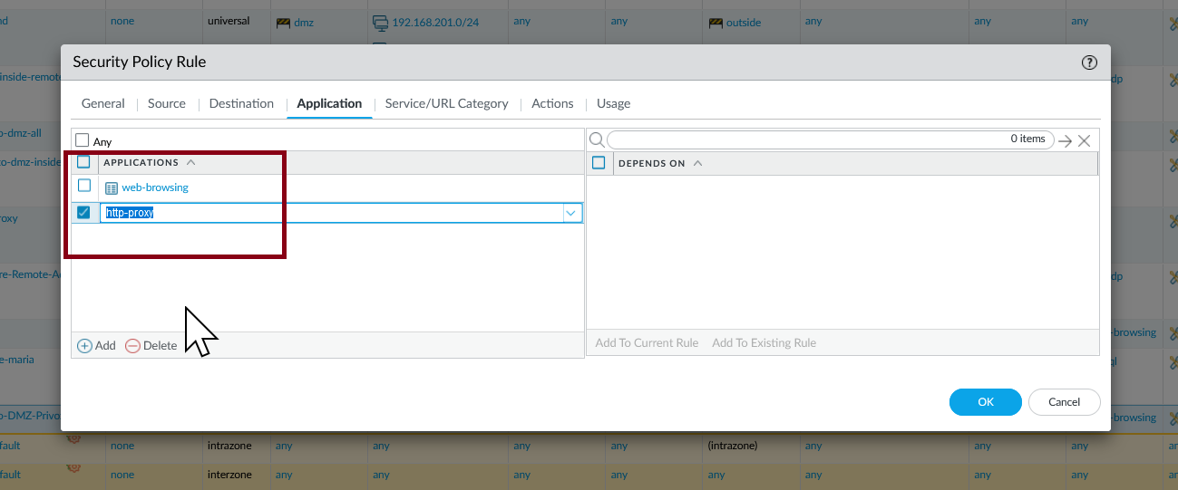
Creating a rule to allow privoxy on the Palo Alto firewall.
If you allow the service maybe it can allow the privoxy service to work. In the policy rule for privoxy add the service required.

Slide 37
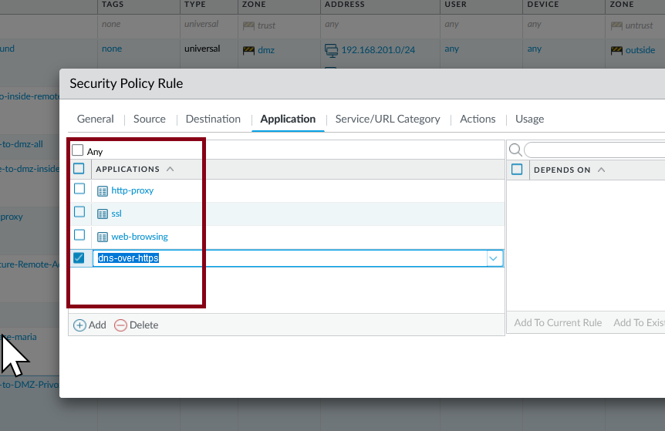
Creating a rule to allow privoxy on the Palo Alto firewall.
After commit the changes and try again another services were asked until we reached to add 4 services, and still a new one was required.

Slide 38
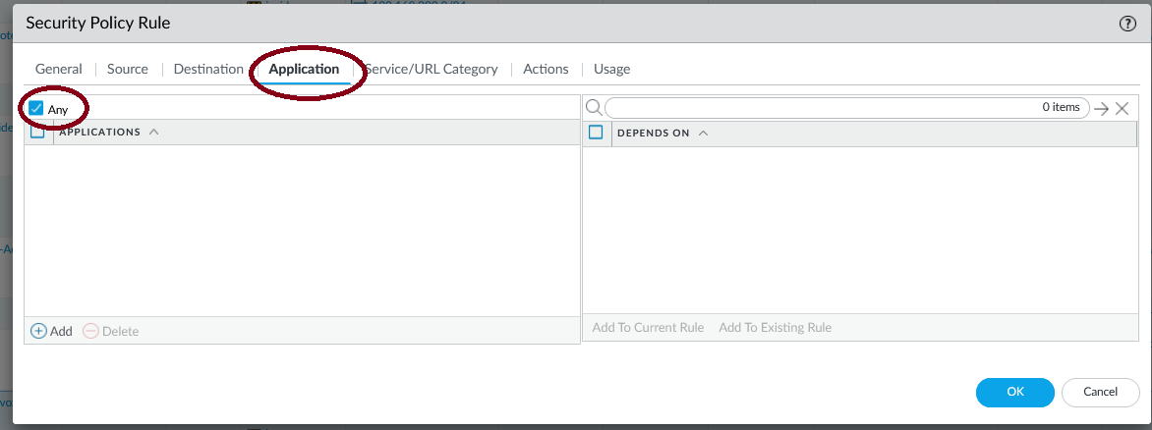
Creating a rule to allow privoxy on the Palo Alto firewall.
Don't do what was showing before. Instead is more useful to use the “any” option in the Application tab of the policy rule. That will allow all necessary protocoles. That change give access to the web service.

Slide 39
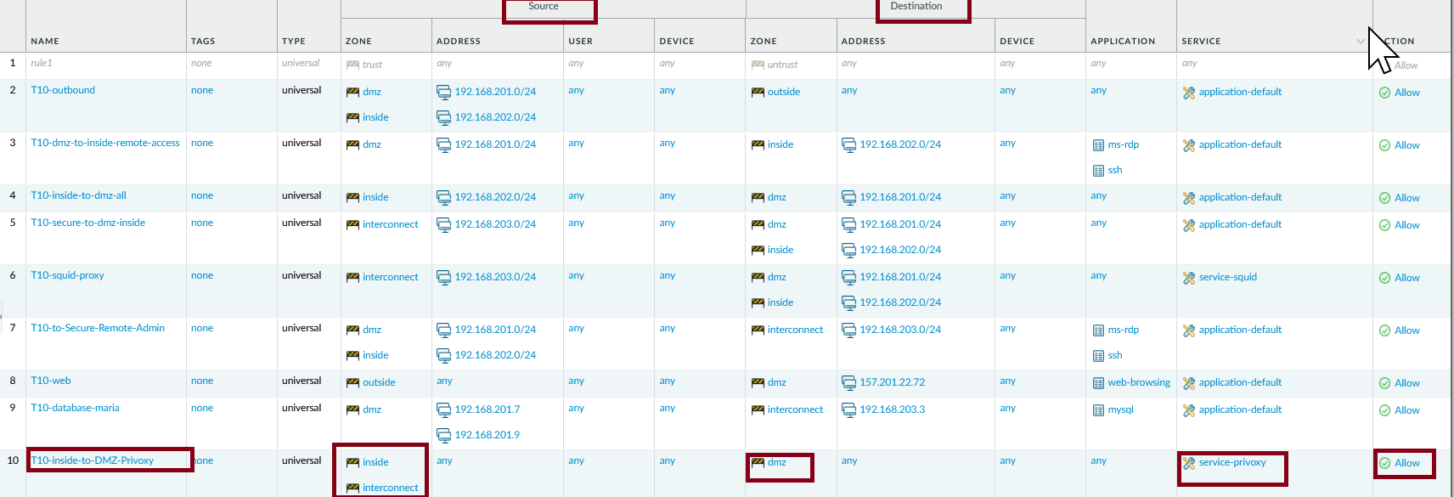
Creating a rule to allow privoxy on the Palo Alto firewall.
The same problem needs solution for the secure zone. Adding the interconnected zone as a new source to the already working rule for privoxy solved communications between the secure and the dmz zone.

Slide 40
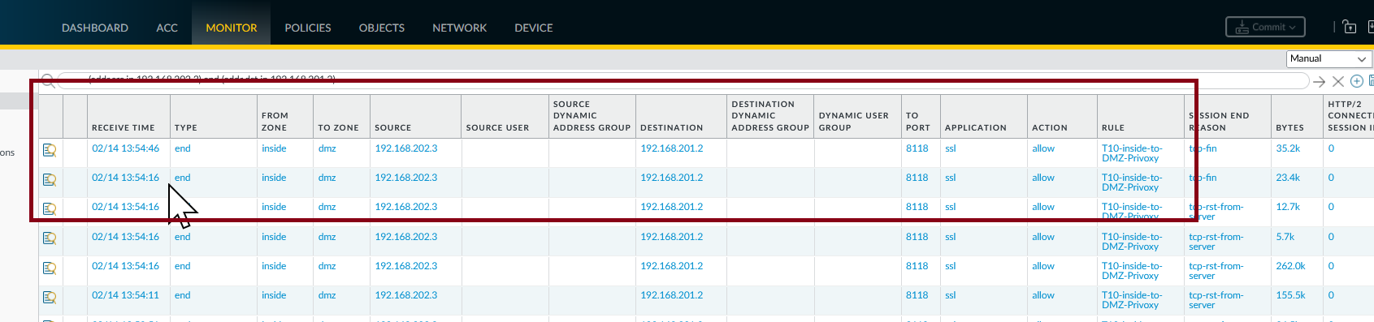
Creating a rule to allow privoxy on the Palo Alto firewall.
Now traffic to the secure and intern zone is allowed for the privoxy services.

Slide 41
Working configuration from the intern zone
This is the proxy configuration on the Alma Linux machine in the intern zone, that now have web services provided by privoxy using port 8118 from the DMZ zone.

